Slide 1
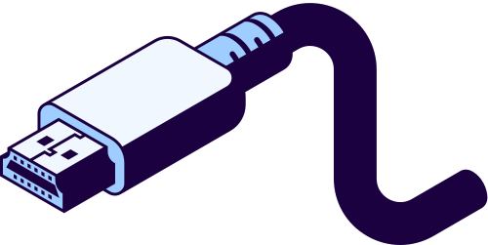
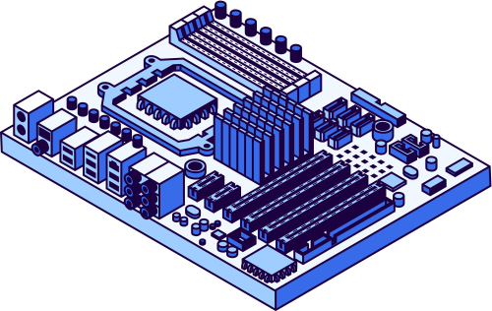
2026
From Waste to Worth: Making Chromebooks Sustainable
BY: MORGAN SCOTT
WWW.REALLYGREATSITE.COM

Slide 2



2026
The Issue with Chromebooks
Chromebooks tend to have a short hardware life
It is difficult to repair or replace parts
the manufactures do not make spare parts.
The internal hardware of the devices are power efficient but are not suited to anything other than light web browsing with few tabs.

Slide 3
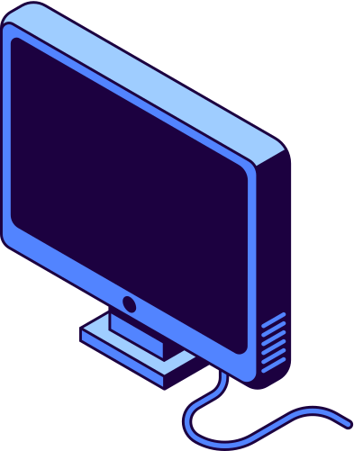
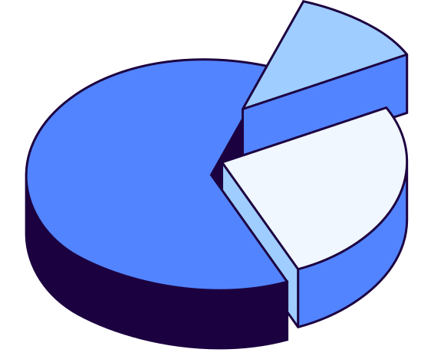
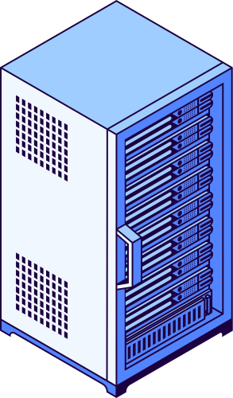
2026
Learning in the Digital Age
“93% OF SCHOOLS PLANNED TO PURCHASE CHROMEBOOKS IN 2025"
•Over 38 million Chromebooks deployed in K-12 schools worldwide as of 2024
•Devices typically lasted only four years in schools before becoming obsolete.

Slide 4
2026
Types of Technology
GIVING NEW DEVICES INSTEAD OF REPAIRING
MANUFACTURES ONLY SUPPORT THE HARWARE FOR A FEW YEARS
WEAK MATERIALS
Some school districts will give students new devices instead of fixing the old devices as it too expensive, time consuming, and difficult to source parts.
Manufactures of devices will stop supporting the hardware after 2-3 years, and on new models they will change minor details to make the parts incompatible with each other.
Chromebooks are made of mostly plastic making parts easy to break even when taking care of the devices.

Slide 5

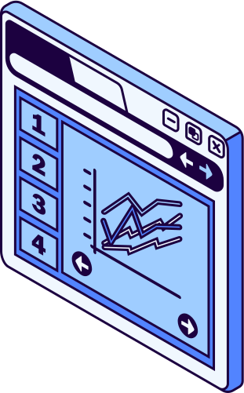


2026
How to Reduce the Waste of Chromebooks
MAKING CHROMEBOOKS EASIER TO REPAIR WOULD REDUCE E-WASTE.
Chromebooks are not easy to repair and are often more cost effective to buy a new device than fixing a broken device. Making the parts easily accessible will allow less Chromebooks to be thrown out as parts are easier to obtain making it easier to repair the device.

Slide 6


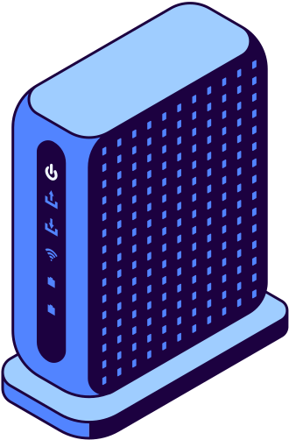


2026
Implementing the Solution
DELL LATITUDES AND LENOVO THINKPADS ARE EASILY FIXED BY THE USER.
The Lenovo Thinkpad T480 was released in 2018, and while the computer is still capable 8 years later, the devices are still easy to repair.
Dell Latitude and Lenovo Thinkpads are commonly used as business laptops so parts are common.

Slide 7
2026
Artificial Intelligence
MAKING PARTS MORE ACCESSIBLE WOULD ALLOW SCHOOLS TO SAVE MONEY.
While Chromebooks are cheap and are made to not last long, making parts more easily accessible would allow for the devices to be used for more than 4 years.
THE PARTS ARE HARD TO OBTAIN ESPECIALLY AS NEW MODELS CHANGE MINOR THINGS TO MAKE THE DEVICES INCOMPATIBLE WITH EACH OTHER.
•An example is the Bezels on the Dell 3100 and the Dell 3110. The 3110s use shorter clips making it impossible to use a 3100 bezel on a 3110 and vice versa.
•The screens on the 2-in-1 versions of the Dell 3100 and 3110 are not compatible with each other for the same reasons.

Slide 8
2026
Positive vs Negative
POSITIVE
NEGATIVE
•By making parts more accessible there will be less E-waste as the devices can be in service for longer.
•The devices will not have to be discarded when the Chromebooks break, whether they are damaged or just standard wear and tear.
•Allowing the devices to be easily re-flashed would allow the devices to safely be used even after the AUE.
•If the devices only have hardware that is hard to find and is not supported for a long time, it will cause more devices to be thrown out, as the devices are unrepairable or it is just cheaper to replace the device.
•By leaving the bootloader how it is, it is very time consuming making it not worthwhile to re-flash the operating system.

Slide 9
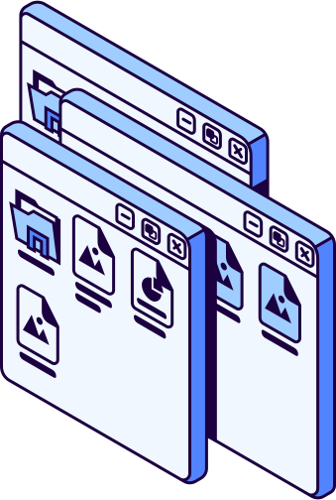
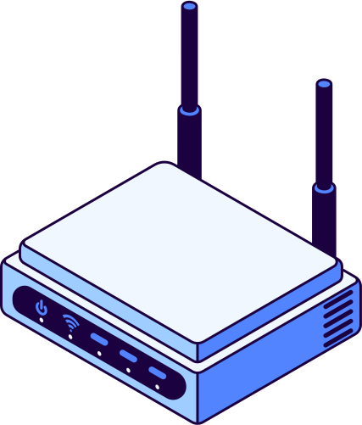
2026
Conclusion
CHROMEBOOKS ARE CURRENTLY DIFFICULT TO REPAIR DUE TO LACK OF EASILY ACCESSIBLE PARTS
In 2023, after backlash from the public and environmental advocacy groups google decided to extend the AUE for devices made after 2021 to 10 years compared to the old 5 years of support that the devices originally had.
By providing backlash to manufacturers of Chromebooks and requiring them to support the hardware of the devices for longer it will prevent more e-waste as the devices can get to their AUE reliably and go on past it

